Slide 1

Notes:
1

Slide 2
Organization
Organization is a system which operates through human activity.
Organizations are very complex social formations, their links can’t be described with only one theory.
Organization Theories concerns 3 levels:
Macro: cooperation among different organization
Mezzo: structures of the organizations, and influencing factors
Micro: behavior of the members of the organizations, motivation, conflict etc.

Slide 3
What is Management?
Definition: Process of designing and maintaining an environment in which individuals working together in groups efficiently accomplish selected aims.

Slide 4
Managers carry out various managerial functions
This applies to any kind of organisation
Applies to all managers at all organisational levels
Creation of surplus

Slide 5
In the book, In search of excellence, Thomas Peters and Robert Waterman identified 43 companies as excellent :
Action oriented
Learned about needs of customers
Promoted managerial autonomy and entrepreneurship
Achieving productivity by paying close attention to people
Driven by company philosophy based on values of their leaders

Slide 6
Business focus (on what they know best)
Simple organisation structure with a lean staff
Centralisation vs decentralisation depending on appropriateness.

Slide 7

Getting work done through others
Efficiency
Effectiveness
Notes:
7
Management is getting work done through others.
Managers have to be concerned with efficiency and effectiveness in the workplace. Efficiency is getting work done with a minimum of effort, expense, or waste. Effectiveness is accomplishing tasks that help full organizational objectives, such as customer service and satisfaction.

Slide 8
Efficiency is achievement of goals with least available resources
Effectiveness is accomplishment of goals

Slide 9

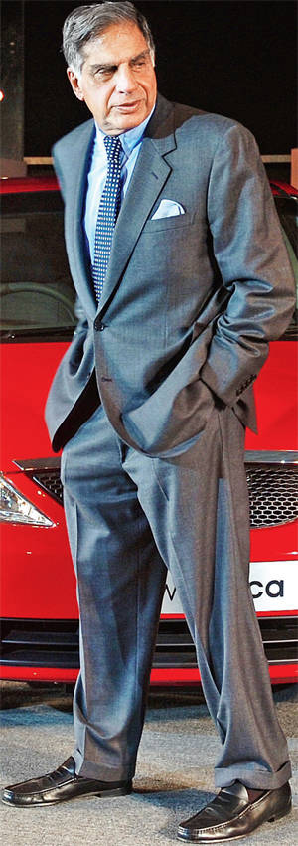
Did you know that: Upon graduating, he turned down an offer from IBM on the advice of JRD Tata Started his career with: Tata Steel, on the shopfloor Leadership style: Aloof and understated, but always on the ball Famous Quote: "I don't believe in taking right decisions. I take decisions and then make them right"

Slide 10
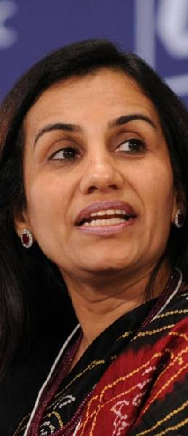
Managing Director & Chief Executive Officer, ICICI Bank
Leadership Style: Meticulous, demands excellence Famous Quote: "Demands do not go up or down — they are constantly there. Often, you feel you are doing too much."

Slide 11
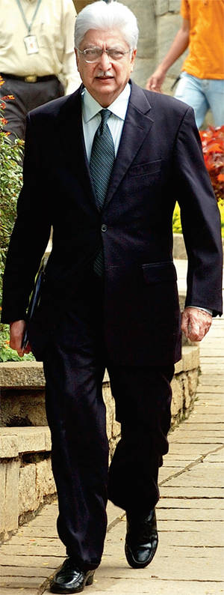
Famous quote: "As you get bigger, you have to delegate. It's also an excellent way to get staff involved in the company's operations.
Icon: JRD Tata
Leadership style: Knows every small detail of his businesses, but does not interfere with everyday operations of the various independent business heads

Slide 12

Interpersonal
Informational
Decisional
Figurehead
Leader
Liaison
Monitor
Disseminator
Spokesperson
Entrepreneur
Disturbance Handler
Resource Allocator
Negotiator
Notes:
12
Interpersonal Roles–interacting with others
figurehead role: managers perform ceremonial duties
leader role: managers motivate and encourage workers to accomplish organizational objectives
liaison role: managers deal with people outside their units
Informational Roles–obtaining and sharing information
monitor role: managers scan their environment for information, actively contact others for information
disseminator role: managers share the information they have collected with their subordinates and others in the company
Decisional Roles–making good decisions
entrepreneur role: managers adapt themselves, their subordinates, and their units to incremental change
disturbance handler role: managers respond to pressures and problems so severe that they demand immediate attention and action
resource allocator role: managers decide who will get what resources and how many resources they get
negotiator role: managers negotiate schedules, projects, goals, outcomes, resources, and employee raises

Slide 13

Classical Management Functions
Updated Management Functions
Planning
Organizing
Staffing
Leading
Controlling
Making Things Happen
Meeting the Competition
Organizing People, Projects, and Processes
Notes:
13
Classical functions of management are planning, controlling, organizing, and leading.
Planning is determining organizational goals and a means for achieving them. Controlling is monitoring progress toward goal achievement and taking corrective action when progress isn’t being made. Organizing is deciding where decisions will be made, who will do what jobs and tasks, and who will work for whom in the company. Leading is inspiring and motivating workers to work hard to achieve organizational goals.
Old-style managers think of themselves as the “manager” or the “boss.” New-style managers think of themselves as sponsors, team leaders, or internal consultants. Old-style managers follow the chain of command (reporting to the boss, who reports to the next boss at a higher managerial level, etc.), while new-style managers work with anyone who can help them accomplish their goals. Old-style managers make decisions by themselves. New-style managers ask others to participate in decisions. Old-style managers keep proprietary company information confidential. New-style managers share that information with others. Old-style managers demand long hours. New-style managers demand results.
Note that these new functions do not replace the classical functions of management; they build on them.
The textbook is organized around the four updated management functions, as shown on this slide, which have evolved out of the classical functions.

Slide 14

CEO
COO
CIO
Top Level Management
General Mgr
Plant Mgr
Regional Mgr
Middle Level Management
First-Line
Management
Office Manager
Shift Supervisor
Department Manager
Team Leader
Notes:
14
The jobs and responsibilities of the four kinds of managers are shown in Exhibit 1.2.

Slide 15

Responsible for…
Creating a context for change
Developing attitudes of commitment and ownership in employees
Creating a positive organizational culture through language and action
Monitoring their business environments
Notes:
15
Top managers hold positions like chief executive officer (CEO) or chief operating officer (COO) and are responsible for the overall direction of the organization.

Slide 16

Responsible for…
Setting objectives consistent with top management goals, planning strategies
Coordinating and linking groups, departments, and divisions
Monitoring and managing the performance of subunits and managers who report to them
Implementing the changes or strategies generated by top managers
Notes:
16
Middle managers hold positions like plant manager, regional manager, or divisional manager.
Note how middle managers’ responsibilities are influenced by those of top managers.
Note also how their responsibilities are more narrowly focused than of top managers.

Slide 17

Responsible for…
Managing the performance of entry-level employees
Teaching entry-level employees how to do their jobs
Making schedules and operating plans based on middle management’s intermediate-range plans
Notes:
17
First-line managers hold positions like office manager, shift supervisor, or department manager.
First-line managers are the only managers who don’t supervise other managers.
They are closest to employees and have daily contact with employees.

Slide 18

Technical Skills
Human Skill
Conceptual Skill
Design/motivational Skill
Notes:
18
Technical skills are most important for lower level managers, because these managers supervise the workers who produce products or serve customers. Team leaders and first-line managers need technical knowledge and skills to train new employees and help employees solve problems. Technical skills become less important as managers rise through the managerial ranks, but they are still important.
Human skills are equally important at all levels of management, from first-line supervisors to CEOs. However, because lower level managers spend much of their time solving technical problems, upper level managers may actually spend more time dealing directly with people.
Conceptual skill is the ability to see the organization as a whole, how the different parts of the company affect each other, and how the company fits into or is affected by its external environment. Conceptual skill increases in importance as managers rise through the management hierarchy.
Managers typically have a stronger motivation to manage than their subordinates, and managers at higher levels usually have stronger motivation to manage than managers at lower levels.
Furthermore, managers with stronger motivation to manage are promoted faster, are rated by their employees as better managers, and earn more money than managers with a weak motivation to manage.

Slide 19
Core skills and their use in the different levels
Managerial levels
Lower
Middle
Top
Conceptual skills
Human skills
Technical skills

Slide 20
Effective & successful managers
Successful managers – defined operationally in terms of the speed of their performance within the organisation
Effective managers – defined in terms of the quantity & quality of standards of performance & the satisfaction & commitment of subordinates

Slide 21
The golden rule management philosophy
Trust people fairly but according to merit
Make others feel important
Motivate people by praise
Encourage feedback
Sandwich every bit of criticism between two layers of heavy praise
Have an open-door philosophy
Help other people get what they want
Never hide behind policy or pomposity

Slide 22
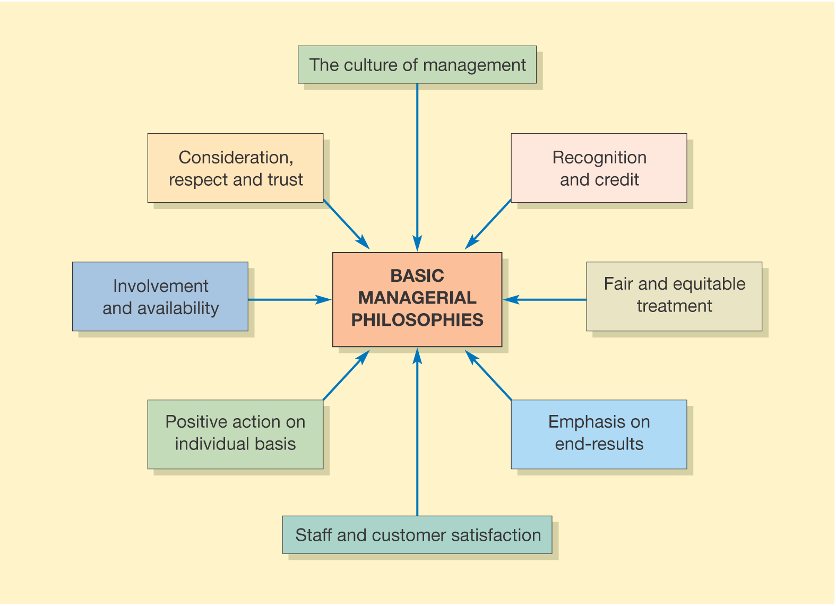
The effective management of people

Slide 23
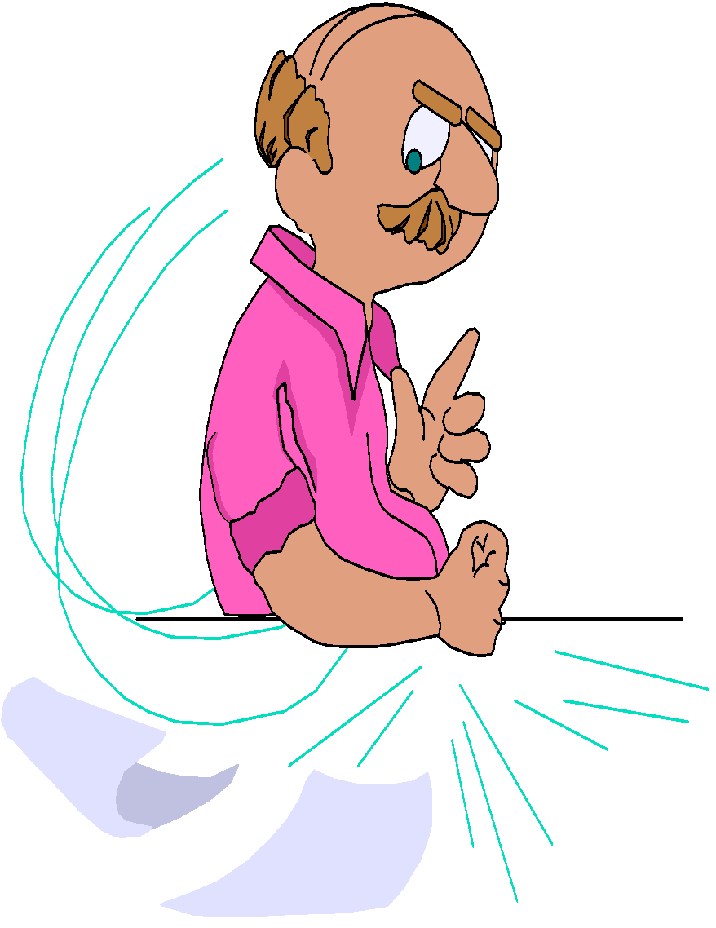
Old Manager
Thinks of self as manager or boss
Works within a set organizational structure
New Manager
Thinks of self as sponsor, team leader, or internal consultant
Changes organizational structure in response to market change

Slide 24
Old Manager
Makes most decisions alone
Hoards information
Tries to master one major discipline
Demands long hours
New Manager
Invites others to join in decision making
Shares information
Tries to master broad array of disciplines
Demands results

Slide 25
Assessing a manager’s effectiveness
The strength of motivation & the morale of staff
The success of their training & development
The creation of an organisational environment in which staff work willingly & effectively
Meeting important deadlines
Accuracy of work
Level of complaints
Adherence to quality standards
Productivity
Adhering to budgets set

Slide 26
Success Domains
Relationships
Personal
Growth
Work
Spirituality
Material
Wealth
Power
Integrity
Health
Key is Balance

